Slide 1
Measuring phylogenetic signal of microbial dynamics
Fall 2021 COMS 6901E Presentation
Haojun Li – hl3509
Supervisor: Philippe Chlenski

Slide 2
Introduction:
Main Question: To what extent do we expect the Peak-to-Trough Ratio (PTR) of closely related species to be more similar than the PTR of randomly selected species from the same Phylogenetic Tree.
In order to answer this question, we need to explore the Phylogenetic Signal
Phylogeny defined as the evolutionary history of the relationships between all living things.
Notes:
PTR defined as “an estimate of bacterial growth was then determined from the ratio of sequencing coverage at the ori compared to the ter” (Pienkowska et al., 2019)
Phylogenetic Signal measures the existence of the situation that related species tends to more statistical dependences on given traits compared with species drawn randomly from the same Phylogenetic Tree.

Slide 3
Goal:
Apply Pagel’s λ, introduced as “a scaling parameter for the phylogeny and measures phylogenetic dependence of observed trait data” (Münkemüller et al., 2012), on our processed data to measure Phylogenetic Signal.
Since presently no Python package exists to estimate phylogenetic signal from tree-structured data, and analyses of phylogenetic signal, this project will develop such an open-source package in Python to achieve those functionalities.

Slide 4
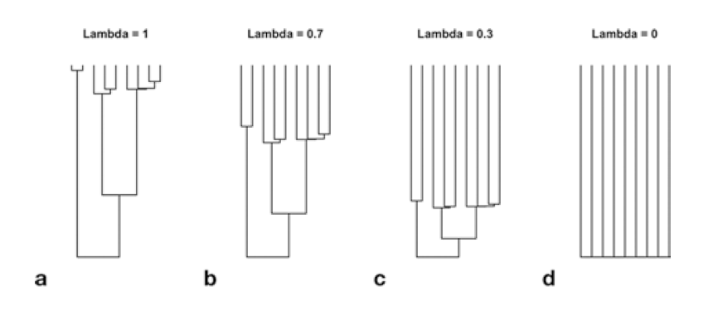
Brownian motion and λ
(Meireles et al., 2020)
Notes:
Brownian motion model is defined as moving along a scale and, in any given moment, there’s a constant variance of the places that you will go to. The core of Brownian motion is the normal distribution.
The covariance of two different leaves can be obtained by getting their first common ancestor and compute its distance to the root. The covariance of two same leaves can be computed by getting its distance to the root.
Pagel’s λ builds upon the idea of the Brownian motion model, besides it scales the off-diagonal elements of covariance matrix of the Brownian motion model by λ.
“Pagel’s lambda is equivalent to scaling the internal branches of the phylogeny, which reduces the expected covariance between species due to evolutionary history.” (Meireles et al., 2020)
varies from 0 to 1. When λ = 1, the model is Brownian motion model and when λ = 0, the model is an independent model (unrelated with each other)
one way to obtain a high phylogenetic signal (λ near 1) is to evolve traits under a Brownian motion model, which involves completely unconstrained character evolution (Harmon & Open Textbook Library, 2019)

Slide 5
Data:
Sanity Check Data:
  Seed plants dataset (Paquette et al., 2015)
  Pagel’s λ correctness check (Simjoly)
Project Data:
  The Phylogenetic tree and tree meta data from IGGdb(Snayfach)
  PTR data (Annavajhala et al., 2019)
  CoPTR (Compute PTR) (Joseph et al., 2021)
Notes:
coPTR + annavajhala et al dataset = our dataset
coPTR used IGGdb for alignment

Slide 6
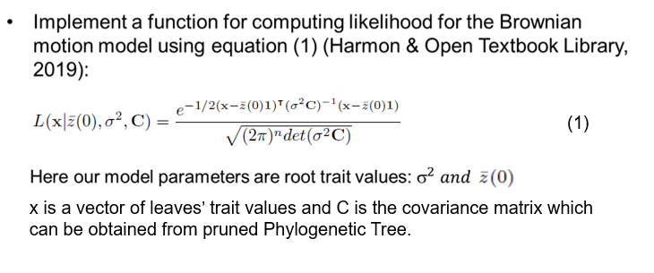
Steps:

Slide 7


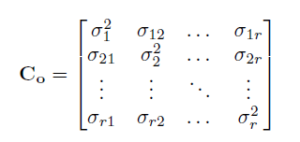
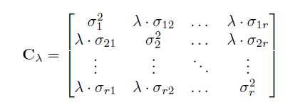
Steps:
Implement function applies Maximum Likelihood Method (MLE) to estimate parameters for the likelihood of Brownian motion model based on equal (2) and (3) (O’Meara et al. 2006):
Implement function that scales off-diagonal elements of covariance matrix C by λ based on the definition function of Pagel’s λ (Harmon & Open Textbook Library, 2019):
(2)
(3)
Pagel’s λ
Notes:
The trait vector x remain unchanged

Slide 8
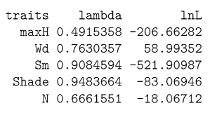

Steps:
Implement functions apply the idea of MLE to search λ value within its range (0 to 1) with specific step size.
Perform Sanity Check:
  Results executed in R (Simjoly) by using officially implemented functions:
  Results of our code with step size = 0.01:
Notes:
Linear search helps us inspect the shape of graphs
The reasons why we do not have value for trait “Sm” are because 1. The data will cause overflow error in Python float; 2. the final result will be too small to compare.

Slide 9
Steps:
After passing sanity check, we applied our implementation for Pagel’s λ on our project data and generated useful plots to observe relationships.

Slide 10
Plots

Slide 11
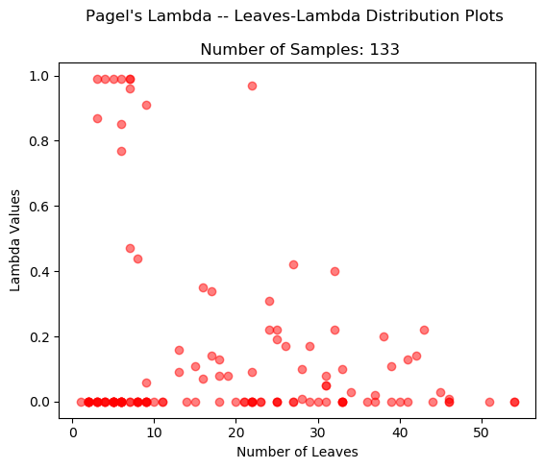
Notes:
This plot displays the relationship between number of leaves and lambda values
Observation: For small number of leaves (< 10), their lambdas values have a large variance. Almost one third of them have really large lambda values which remain above 0.6 and even stay close to one, while another two third of them remain close to 0.
As number of leaves increasing (ignoring the outlier), lambda values tend to concentrated in the area that below lambda value = 0.6.
Also, as the number of leaves increasing, dots tend to be more concentrated and stay around the line where lambda value = 0.

Slide 12
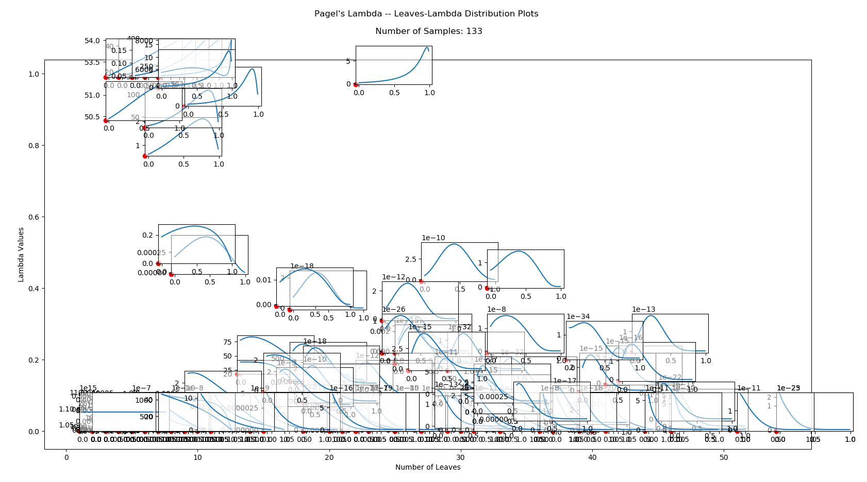
Notes:
On top of previous plots, we plot the relationship between the lambda and likelihood for each dot. These subplots not only display how our implementation performs lambda value search for each trait, but also display the relationship between lambda and likelihood. Most of plots have the shape that is similar to the normal distribution. This distribution meets our expectation since the core of Brownian motion is the normal distribution. When lambda value closes to 1, we should observe that feature more clearly. To be more general, they all increase to a global maximum and, then, start to decrease besides several outliers. I will display some plots that clearly have the distribution that I mentioned before and I will also display some outliers.

Slide 13
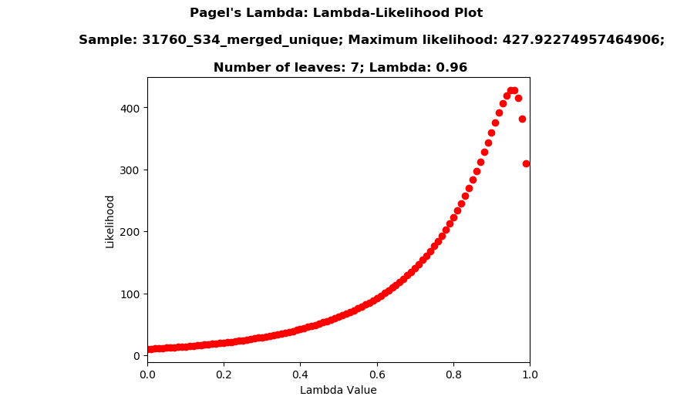
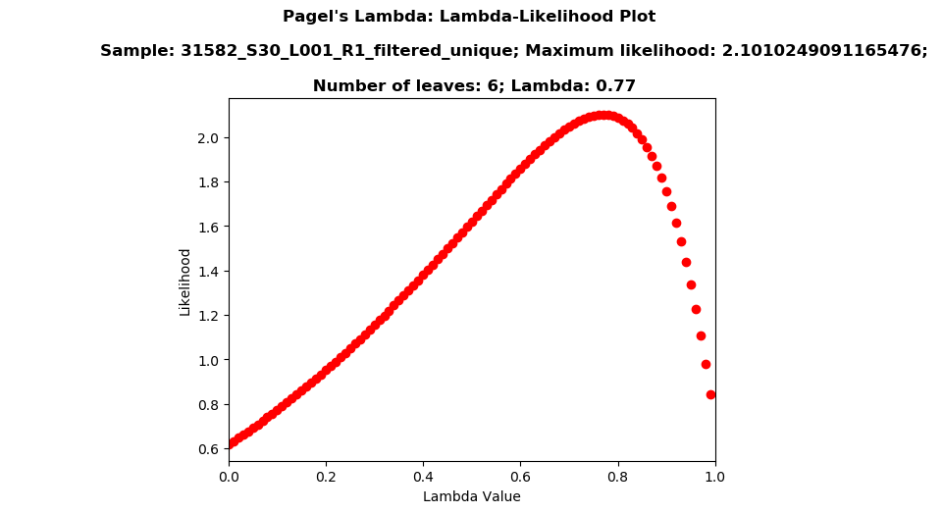
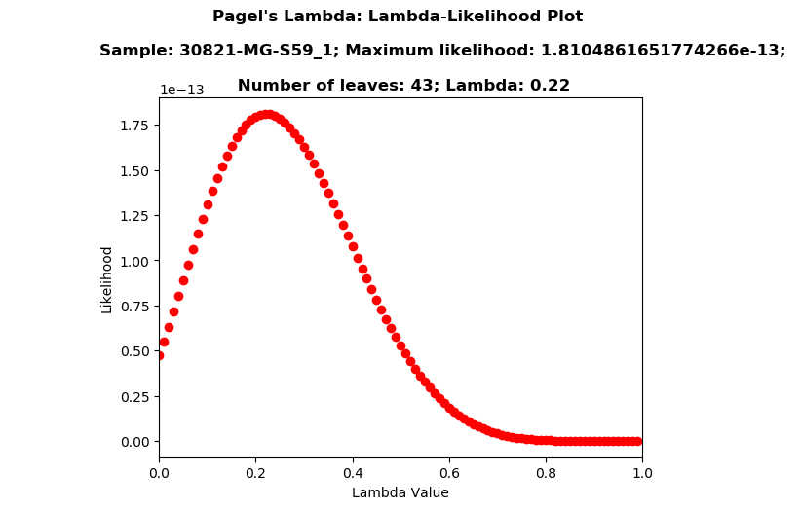
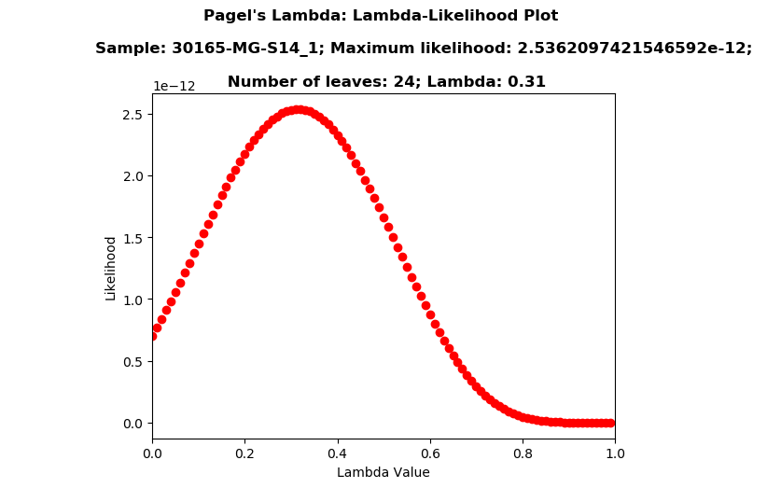
Notes:
Here I display the subset of plots that clearly have the distributions that are similar to the normal distribution. They all increase to a global maximum and then starts to decrease. Thus, for most of plots like this, we can compute gradient to find their global maximum. Next, I will display some representative outliers.

Slide 14
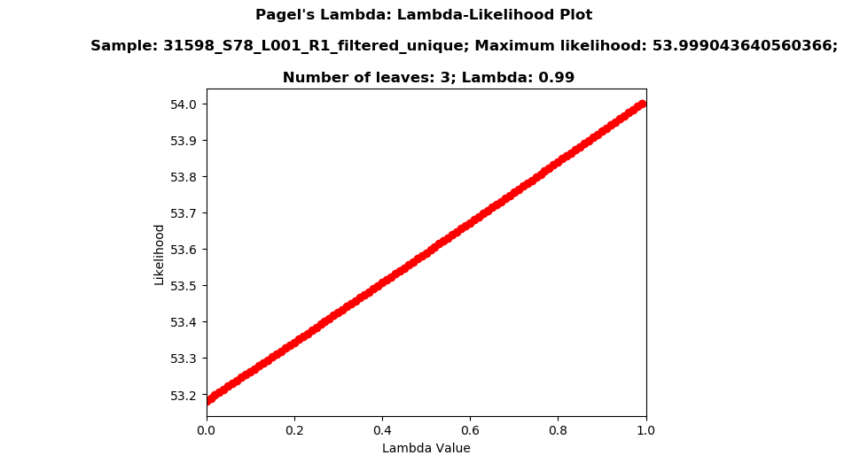
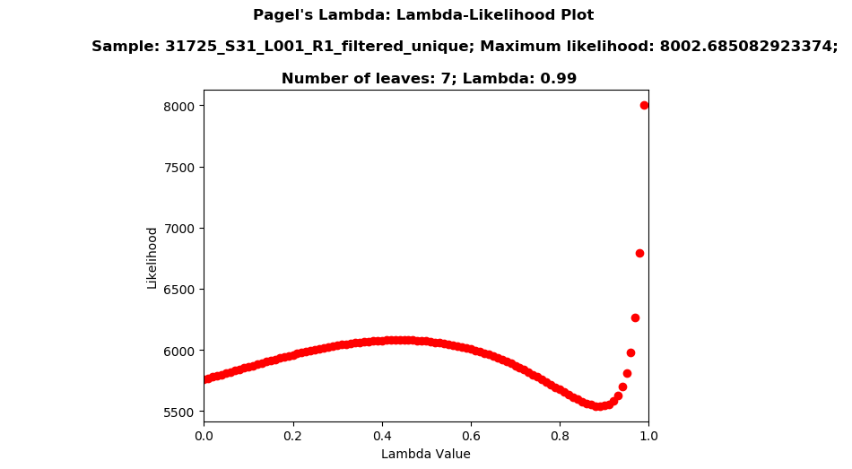
Notes:
Here are two types of representative outliers. For the relationship in the first plot, we observe that, before reaching the global maximum, the relationship is similar to a positive linear relationship (Maximum happens at lambda equals to 0.99). For this situation we can still rely on the gradient method, however, its general shape is unlike the normal distribution. For the second plot, we will have a local maximum and its shape is also unlike the normal distribution. We cannot rely on the gradient method to compute the solution. Since their lambda values are close to 1 and we expect to see distributions that is almost the same as the Brownian motion, we need to go deep into the data to explore more information in the future.

Slide 15
Conclusion:
Most of the lambda-likelihood plots generated for traits has shapes that are similar to normal distribution.
Almost all lambda-likelihood plots increase initially and start to decrease until reaching the global maximum. Thus, gradient method can work well for these cases.
No clear evidence of phylogenetic signal in this system.

Slide 16
Future Work:
Test phylogenetic signal in other PTR estimates
Assess whether all assumptions are appropriate to the data
Continue optimize our Python implementation of Pagel’s λ to reduce more computation time.
  Consider using optimizers provided by Python packages
  Consider using gradient or advanced searching algorithms
Polish our Python implementation and keep good documentation in order to contribute to Python open source packages such as ete3.
Notes:
if we pass all of these tests, this could be evidence for the absence of phylogenetic structure in microbial dynamics

Slide 17
References
Annavajhala, M. K., Gomez-Simmonds, A., Macesic, N., Sullivan, S. B., Kress, A., Khan, S. D., Giddins, M. J., Stump, S., Kim, G. I., Narain, R., Verna, E. C., & Uhlemann, A.-C. (2019). Colonizing multidrug-resistant bacteria and the longitudinal evolution of the intestinal microbiome after liver transplantation. Nature Communications, 10(1), 4715. https://doi.org/10.1038/s41467-019-12633-4
Harmon, L. J. & Open Textbook Library. (2019). Phylogenetic Comparative Methods. https://open.umn.edu/opentextbooks/textbooks/691
Joseph, T. A., Chlenski, P., Korem, T., & Pe’er, I. (2021). Accurate and robust inference of microbial growth dynamics from metagenomic sequencing [Preprint]. Bioinformatics. https://doi.org/10.1101/2021.02.02.429365
Meireles, J. E., O’Meara, B., & Cavender-Bares, J. (2020). Linking Leaf Spectra to the Plant Tree of Life. In J. Cavender-Bares, J. A. Gamon, & P. A. Townsend (Eds.), Remote Sensing of Plant Biodiversity (pp. 155–172). Springer International Publishing. https://doi.org/10.1007/978-3-030-33157-3_7
Münkemüller, T., Lavergne, S., Bzeznik, B., Dray, S., Jombart, T., Schiffers, K., & Thuiller, W. (2012). How to measure and test phylogenetic signal: How to measure and test phylogenetic signal. Methods in Ecology and Evolution, 3(4), 743–756. https://doi.org/10.1111/j.2041-210X.2012.00196.x
O’Meara, B. C., C. Ané, M. J. Sanderson, and P. C. Wainwright. 2006. Testing for different rates of continuous trait evolution using likelihood. Evolution 60:922–933.
Paquette, A., Joly, S., & Messier, C. (2015). Explaining forest productivity using tree functional traits and phylogenetic information: Two sides of the same coin over evolutionary scale? Ecology and Evolution, 5(9), 1774–1783. https://doi.org/10.1002/ece3.1456

Slide 18
References
Pienkowska, K., Wiehlmann, L., & Tümmler, B. (2019). Metagenome – Inferred bacterial replication rates in cystic fibrosis airways. Journal of Cystic Fibrosis, 18(5), 653–656. https://doi.org/10.1016/j.jcf.2019.01.003
Simjoly. (n.d.). Simjoly/CourseComparativeMethods: Examples of application of comparative methods in R. GitHub. Retrieved December 7, 2021, from https://github.com/simjoly/CourseComparativeMethods.
Snayfach. (n.d.). Snayfach/IGGdb: Database of genomes integrated from the gut microbiome and other environments. GitHub. Retrieved December 7, 2021, from https://github.com/snayfach/IGGdb.

Slide 19
Q & A

Slide 20
Thank You !

